Slide 1
CIPE Webinar on Public-Private Dialogue
July 11, 2013
Panelists:
Elias M. Dewah
Lars Benson
Omowumi Gbadamosi
Natalia Otel Belan
Moderated by Kim Bettcher

Slide 2
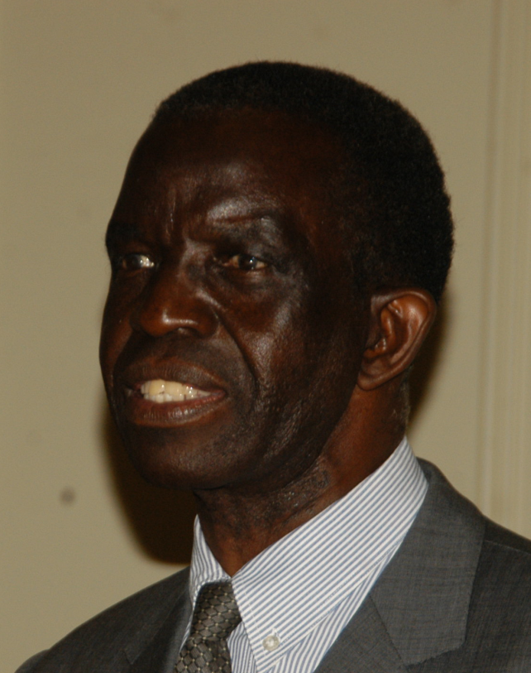
Elias M. Dewah
Mr. Dewah is currently an independent consultant in business, economic development, and democratic governance issues. He specializes in the promotion of Public-Private Dialogue and Business Management Training.
Private Sector Experience:
Executive Director, Botswana Confederation of Commerce, Industry and Manpower
Operations Manager with Shell Oil in Botswana
General Manager for Rural Industries Innovation Centre
Public Sector Experience:
Head of Botswana Trade & Investment Agency
National Director of Commerce and Consumer Affairs
Head of Co-operative Marketing Branch

Slide 3
Public-Private Dialogue
Strengthens policymaking by incorporating private input and creating momentum for reform
Expands participation, improves quality of representation, and supplements democratic institutions
Involves a mutual exchange of views, including bottom-up contributions to policymaking

Slide 4
The Case of Botswana
Structures for public-private dialogue have increased transparency and good governance
Continued dialogue has resolved numerous issues of concern to business
Institutionalized exchanges such as the biennial National Business Conference and High-Level Consultative Council

Slide 5
Effective Practices
To achieve successful dialogue, the Private Sector must:
  exhibit consistency and persistency to overcome entrenched bureaucratic interests
  remain independent from government but work with officials in an advocacy capacity
  be proactive, constructive and ready to come up with well researched policy options
  speak with ONE VOICE at all times
  be representative of all sectors of the economy, not just a few elite businesses

Slide 6
Botswana
Process: The National Business Conference is a biennial event that brings together public and private sector leaders and other stakeholders to discuss Botswana’s major economic and social challenges. The High-Level Consultative Council, chaired by the President of Botswana, meets twice a year for ministerial level dialogue with business leaders.
Results: Formulation of the National Privatization Policy; abolition of exchange controls; establishment of Botswana Export Development and Investment Agency; and reduction in corporate and individual tax rates

Slide 7
Structure of the National
Business Conference
Captains of Industry
Civil Society
Government Officials
Political Parties
Parliament
NATIONAL
BUSINESS
CONFERENCE
RECOMMENDATIONS
RECOMMENDATIONS
IMPLEMENTATION

Slide 8
Kenya
Objective: to strengthen policy advocacy at the local level to improve business climate and encourage greater private sector participation in democratic governance
How: Kenya Association of Manufacturers established loose coalition of 47 business membership organizations across five regions

Slide 9
Kenya
Process: Through meetings and PPD engagements coalition focused on tax issues, infrastructure, and security
Results: Mombasa council cancelled new business taxes. Roads repaired in Nakuru, Eldoret, Kisumu, and Mombasa. Partnerships improve security in Nakuru and Kisumu. New governors promise regular dialogue.

Slide 10
Nigeria
Objective: Improve business environment in North Central Zone of Nigeria through private sector advocacy initiatives.
How: Informal coalitions representing over 1 million small entrepreneurs advocate for policy improvements

Slide 11
Nigeria
Process: Dialogue and meetings with executive and legislative officials focused on security, multiple taxes, infrastructure
Results: Nasarawa Coalition improved electricity allocation to business from 17 to 33 MGW. Niger Coalition reduced number of taxes and established rules for tax collectors, Kwara replaced a signage law

Slide 12
Others
Senegal passed a new finance law with significant private sector input in 2012 after CIPE’s partner used evidence based advocacy to inform and encourage specific reforms
Ethiopian private sector groups made changes to national and local law that favor small business through PPD and advocacy

Slide 13
Moldova PPD
PPD tool: National Business Agenda process
Issues: focused on 2 key policy reform areas
  Tax administration
  Customs procedures
Participants
  Started in 2007 with 12 business associations
  Today over 30 sector-based business associations and chambers of commerce across Moldova

Slide 14
Moldova PPD
Messages
  Transparent
  Constructive
  Positive language
Channels
  Law on transparency in decision-making (previously inactive): NBA Network used it to demand the government to set-up consultative councils at every gov’t agency as prescribed in the law.
  Law on access to information: to gain access to business-related legislation and regulations, including those in the drafting process.

Slide 15
Lessons Learned and Impact
NBA process provided a new paradigm of interaction between private sector and government:
  Lobbying => Advocacy
  Single interests => Broad policy issues
  One transaction => Systemic changes
  Behind doors deals => Open, constant dialogue
Initial NBAs focused on policy proposals. Today, NBA evolved into a tool for monitoring progress of reforms
Government is now requesting NBA Network’s opinions

Slide 16
Thank You!
Questions or comments?
Email partners@cipe.org

